Slide 1

KDD 2022 Tutorial: Deep Learning for Network Traffic Data
https://github.com/manish-marwah/KDD2022Tutorial
Manish Marwah, Martin Arlitt

Slide 2
Network traffic data
Network traffic data is an extremely rich source of information
It is highly voluminous and complex
It has a lot of applications, particularly in areas of
computer security, e.g.,
intrusion detection
malware detection
and network management, e.g.,
device identification
application identification
These can be cast as ML problems, but there are lots of challenges

Slide 3
Outline
Part 1: Network traffic background and challenges
Part 2: Representation learning for network traffic data
Part 3: Synthetic data generation for network traffic data
Notes:
We will cover these with an eye towards application to network traffic data
We will not delve deep into the methods, presenting them only at a high level
Break between each part.

Slide 4
What will not be covered?
Cybersecurity in general
very broad topic; we focus on two specific ML challenges
Different types of attacks, how to prevent/detect them
Attacks against ML detectors
Data attacks, e.g., data poisoning attacks
Detailed description of deep learning methods
Privacy

Slide 5
Part 1: Network Traffic Data
Manish Marwah, Martin Arlitt

Slide 6
Outline
Network traffic data
Applications
Data sets
Challenges
Notes:
What is network traffic data?
Where is it collected?
Formats – raw, processed, sampled
PCAP
Netwflow / sflow
AWS VPC Flow
How is it collected?
Headers vs deep inspection
TLS
Applications
Security
Network management
Challenges from DS perspective

Slide 7
Background: the Internet Protocol stack
Application: supports end-user services and network applications
HTTP, SMTP, DNS, FTP, NTP
Transport: end to end data transfer
TCP, UDP
Network: routing of datagrams from source to destination
IPv4, IPv6, BGP, RIP
Data Link: channel access, framing, flow/error control, hop by hop basis
PPP, Ethernet, IEEE 802.11b WiFi
Physical: transmission of bits

Slide 8

What is Network traffic Data?
Traffic packets captured on the network
Contain protocols headers and data
Different types of traffic – text, video, audio, …
www.istockphoto.com

Slide 9
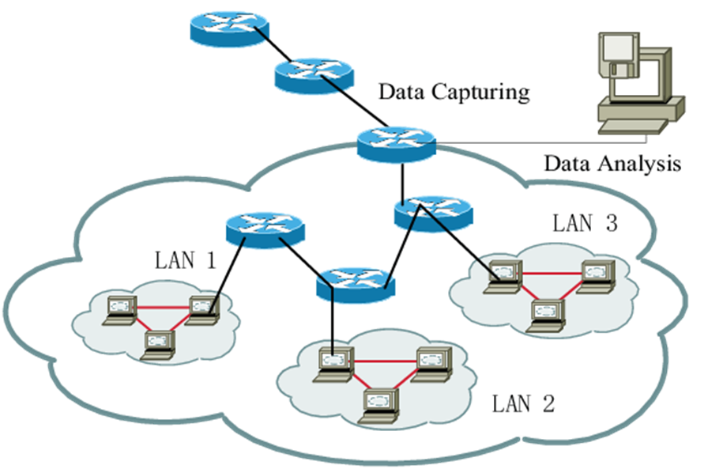
Where is Network Traffic Data Collected?
Usually at an intranet edge where it can capture ingress / egress data
This simplifies collection
It may however not observe all traffic
Internal traffic that doesn’t pass the collection point
Packets that are dropped due to capacity limits of the collection infrastructure
https://www.researchgate.net/figure/The-topology-of-network-traffic-captured-environment_fig2_275415518

Slide 10
How is network traffic data collected?
Either hardware or software measurement tools
Hardware: specialized equipment
Examples: HP 4972 LAN Analyzer, DataGeneral Network Sniffer, NavTel InterWatch 95000, Endace DAG, others...
These are faster, but more expensive ($$$)
Software: special software tools
Examples: tcpdump, wireshark, others...
These are cheaper (free!), but also slower (miss packets)

Slide 11
Tools for packet capture / parsing
tcpdump https://www.tcpdump.org
Unix-based tool from mid-to-late 1980’s
Distributed with BSD Unix (Berkeley Software Distribution)
Command-line interface; must be root to run it
Uses the Berkeley Packet Filter (BPF) in operating system
Writes to a PCAP file format; uses libpcap library
Wireshark https://www.wireshark.org
PC-based tool from the early 2000’s
Formerly called Ethereal (name change in May 2006)
Free and open-source tool
Multi-layer visualization and analysis of packet traces
Also supports PCAP file format

Slide 12
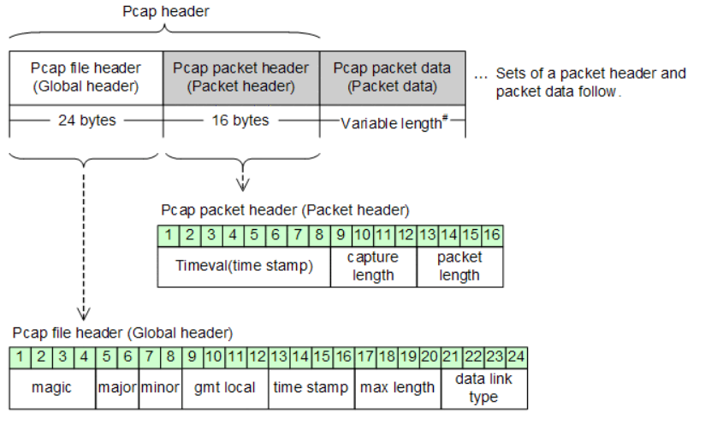
Collection format
pcap (“packet capture”)
Defines format and API for capturing network packets
Libpcap available from tcpdump.org
http://itdoc.hitachi.co.jp/manuals/3020/30203V0200e/BV020176.HTM

Slide 13
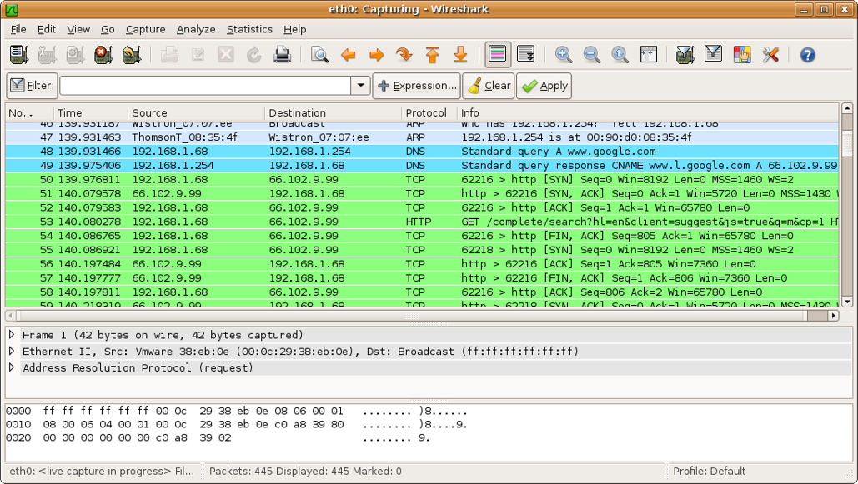
Wireshark example

Slide 14
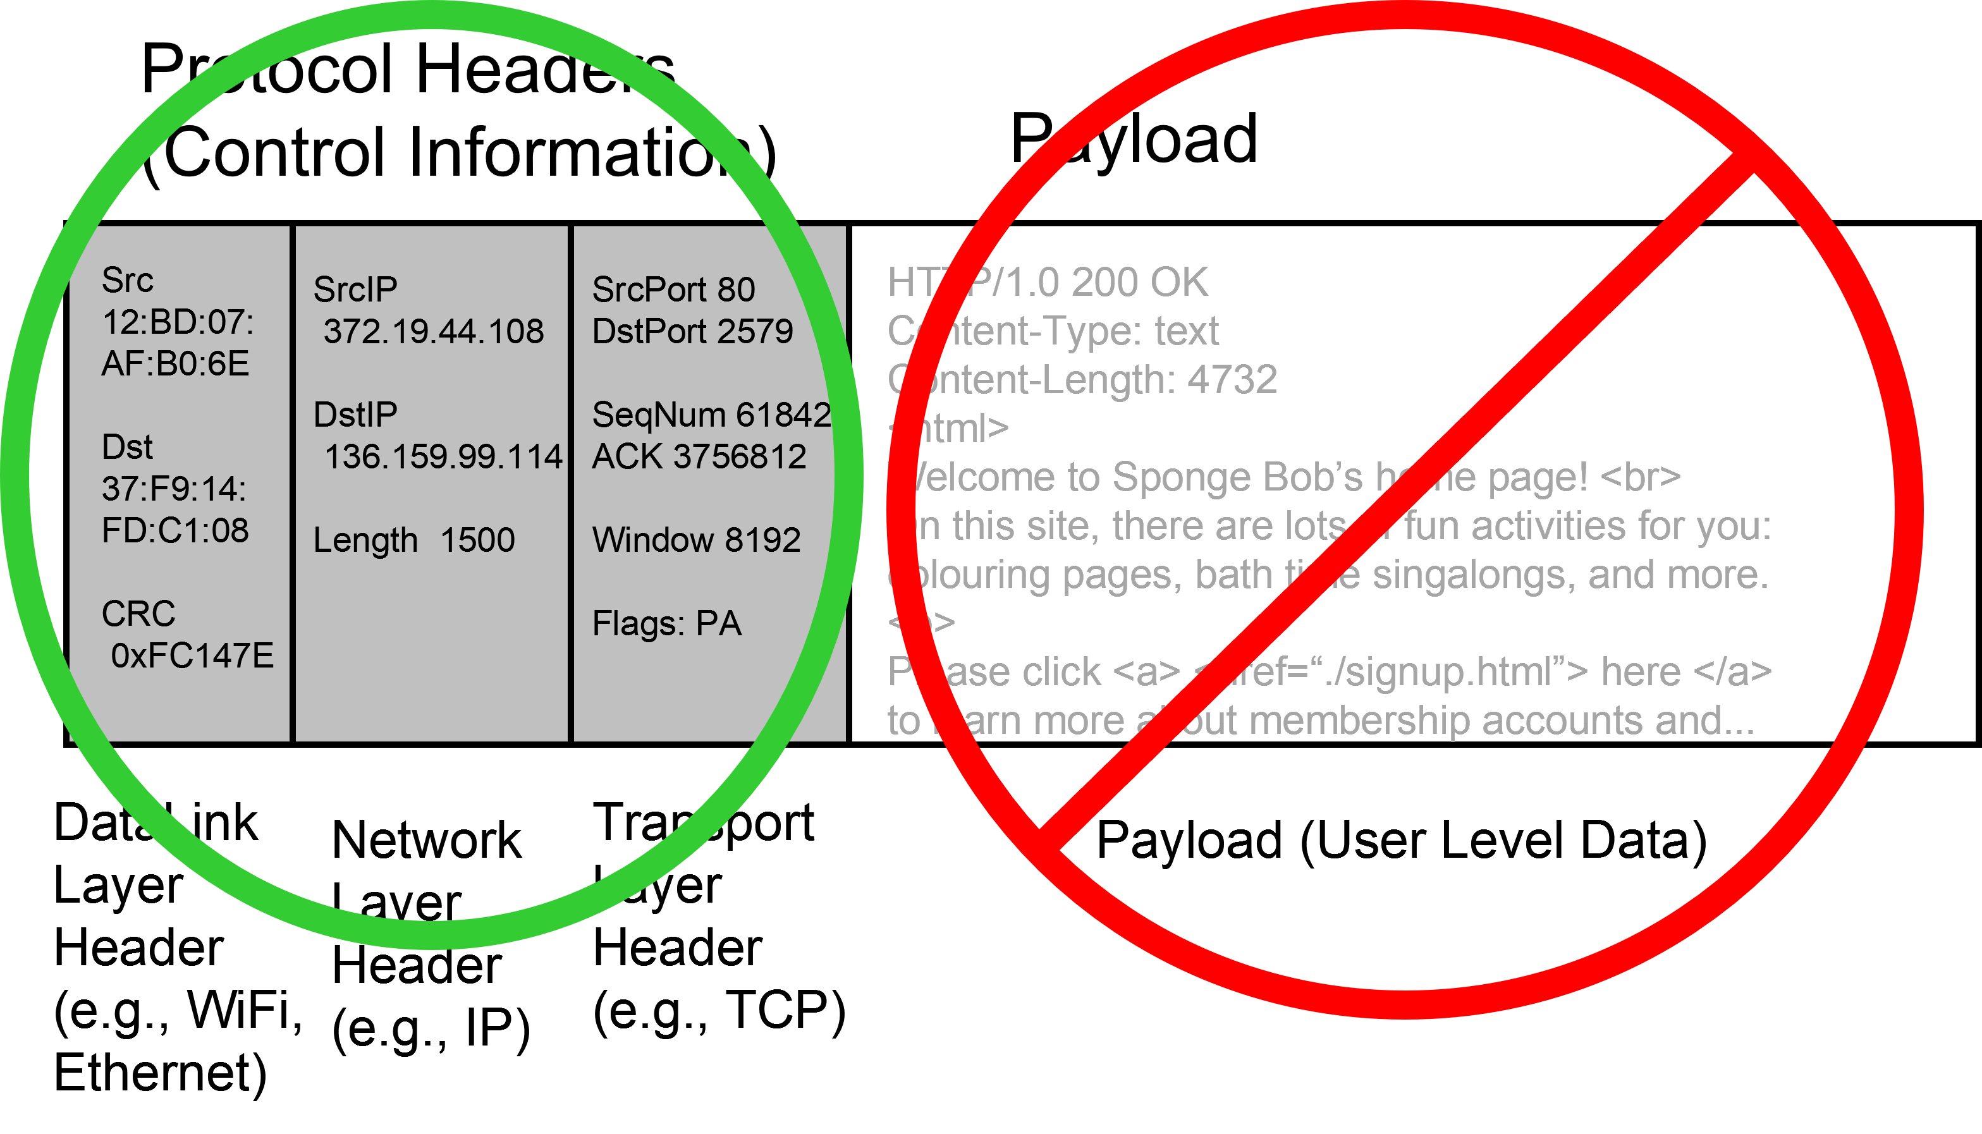
Packet headers vs Deep Packet Inspection
Sometimes it makes sense to only examine a packet’s headers rather than its payload

Slide 15
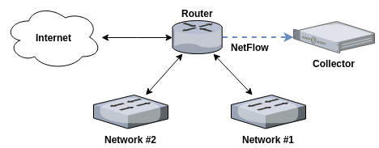
Flow-based traffic data
Netflow
Introduced on Cisco routers in 1996
Multiplexes one or more packets into a “flow”
Each record summarizes a unidirectional flow
Main Fields
Connection 5-tuple
Src IP
Src Port
Dst IP
Dst Port
Transport protocol
https://cylab.be/blog/42/collecting-and-processing-netflow-on-ubuntu
Start timestamp
Duration
Number of bytes
Number of packets
TCP flags

Slide 16
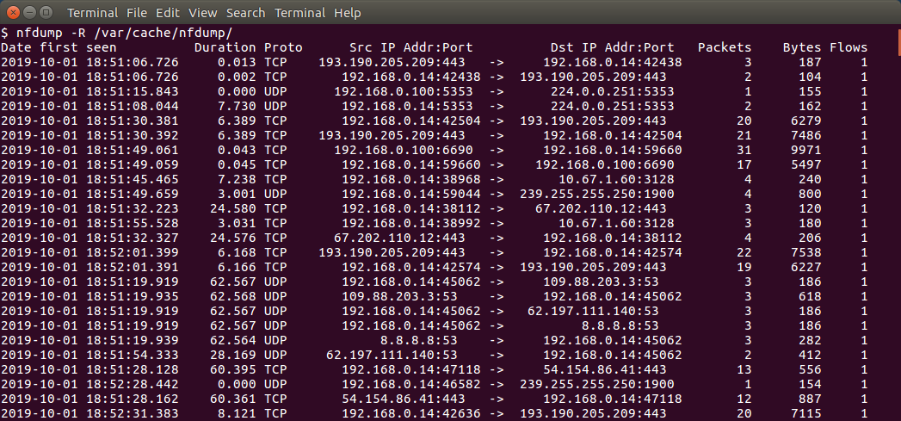
Netflow example

Slide 17
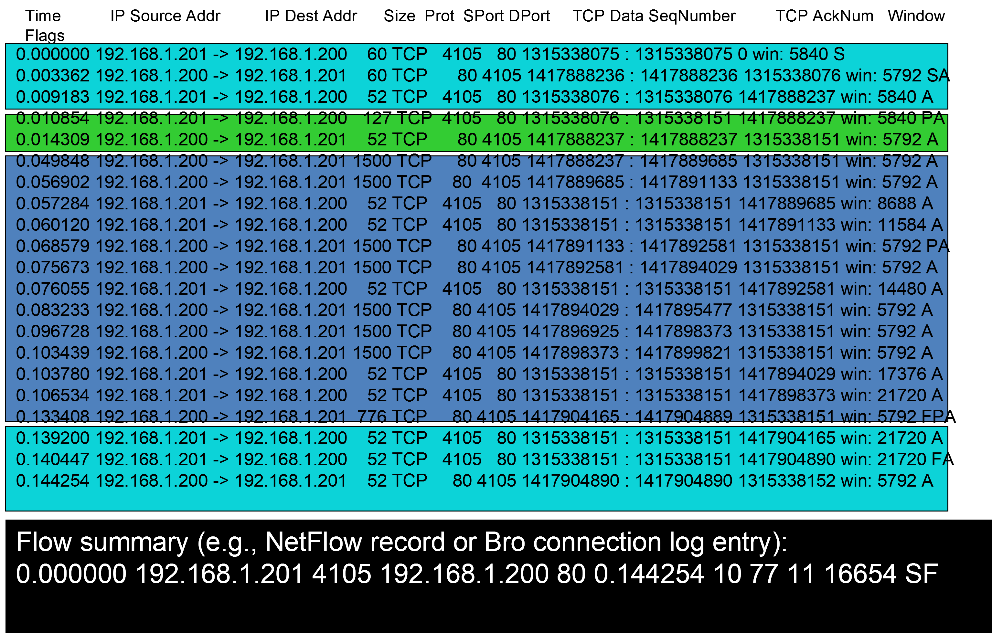
Comparing a packet trace to a flow record

Slide 18
Flow data in the cloud
Cloud computing infrastructure (e.g., AWS) allows collection of flow logs
AWX VPC Flow logs provide flow summaries similar to Netflow
A key distinction is the VPC Flow logs summarize network activity for a specific “virtual private cloud”
Activity from multiple VPCs could potentially traverse the same Netflow enabled device
In other words, VPC Flow logs are similar to network logs that have been demultiplexed

Slide 19
Encrypted vs Unencrypted
Use of TLS for encrypting network data has been increasing
TLS encrypts transport layer packet payload
However, application layer protocols are encrypted
Netflow is unaffected

Slide 20
Network Traffic Data Formats
Packets (e.g., pcap)
Flows
Unidirectional (e.g., netflow)
Bidirectional (e.g., IDS (zeek), firewall (check point))
Sampled flows (e.g., s-flow)

Slide 21
Data Sets

Slide 22
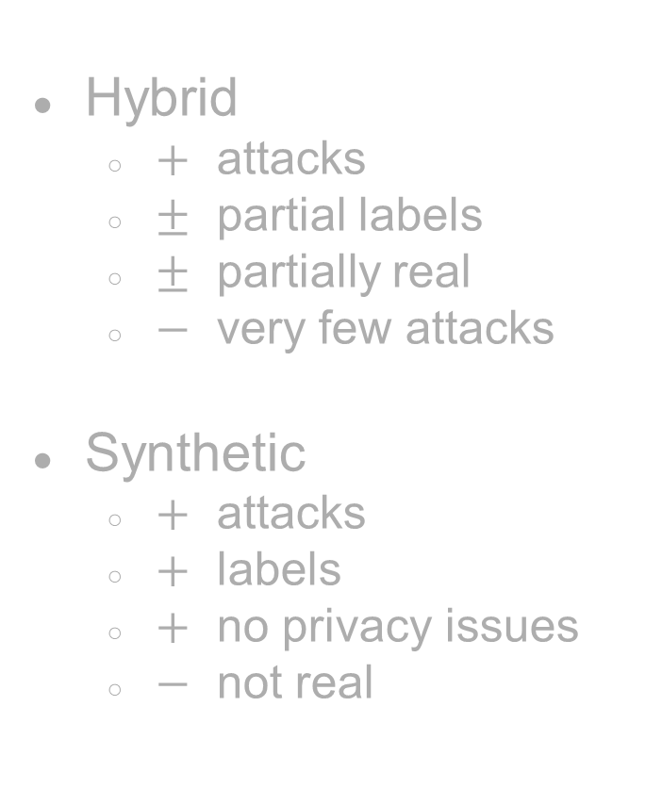
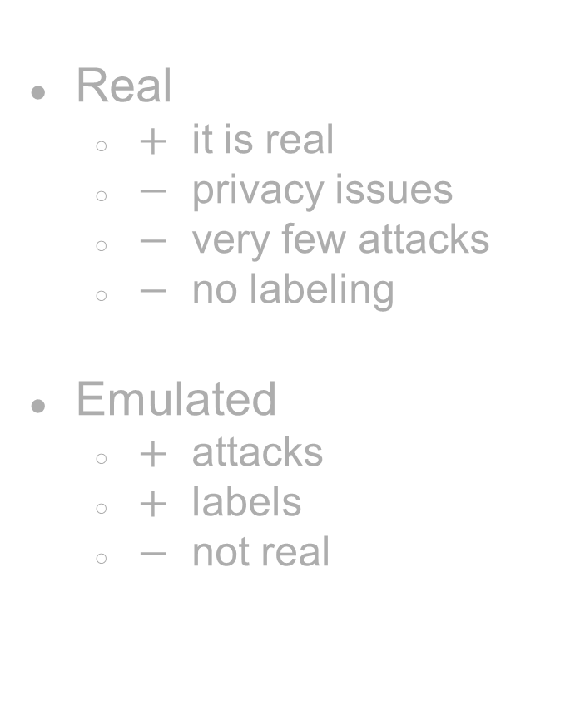
How to create a network traffic data set with attacks?
Real
$+$ it is real
$−$ privacy issues
$−$ very few attacks
$−$ no labeling
Emulated
$+$ attacks
$+$ labels
$−$ not real
Hybrid
$+$ attacks
$±$ partial labels
$±$ partially real
$−$ very few attacks
Synthetic
$+$ attacks
$+$ labels
$+$ no privacy issues
$−$ not real

Slide 23
How to label a data set?
Through emulation
Use rules
Use a ML model
Synthetic
Automated labeling

Slide 24
Other data set considerations
Duration and size
Packets vs Flows
Meta information
Anonymized fields
Unidirectional vs bidirectional flows
Class imbalance

Slide 25
Examples of publicly available network traffic data sets
University of New Brunswick [CICIDS]
Australian Centre for Cyber Security [UNSW-NB]
University of Coburg [CIDDS-001]
CTU-13
UGR-16
Ring et al., A Survey of Network-based Intrusion Detection Data Sets, https://arxiv.org/pdf/1903.02460.pdf

Slide 26
Network Traffic Data Sets
How are data sets generated?
Real
Emulated
Synthetic
Normal traffic vs attack traffic
How are data sets labeled?
During emulation
Using some rules / already trained ML model
Not labeled
Format
Packets or flows
Unidirectional or bidirectional flows
Duration

Slide 27
Applications

Slide 28
Why is network traffic data collected?
Network Management perspective
To understand the traffic on existing networks
For workload characterization and modeling
To guide the design of future networks
For performance evaluation of network protocols and applications
For debugging network protocols and applications
Security perspective
For network security monitoring
For threat hunts and investigations

Slide 29
A lot of these can be cast as ML problems
Intrusion detection and prevention
Malware detection and prevention
Other attack detection, e.g., DOS
Search, e.g., find similar attacks
Device Identification
Traffic classification
Application identification
Website fingerprinting

Slide 30
Challenges

Slide 31
Data Science Challenges
Big Data
Even small networks can carry a lot of packets/flows
Analytics need to have good performance and scalability to be useful in practice
Granularity of the data
Details are often shed to reduce the overhead of collecting and storing network data
Lack of labeled data
SMEs are often too busy to spend time labeling data
The diversity of activities on a network further complicates the matter
Understanding the data
Encryption, virtualization, containerization, NATs, etc., all obscure the sender/recipient and communication
Privacy and Security
Certain fields may be missing or obscured due to privacy and security policies and regulations

Slide 32
Challenges
Lack of data sets that are
publicly available
representative
Labeled – requires both effort and expertise
Privacy and security
High volume
granularity

Slide 33
Challenges
Complex
Difficult to understand
Due to encryption, virtualization, containerization, NAT’s, etc.
Heterogeneous
Temporal and within-row dependencies
Long-tailed
Non-stationarity
Adversary
Validation

Slide 34
References
Sommer, Robin, and Vern Paxson. "Outside the closed world: On using machine learning for network intrusion detection." 2010 IEEE symposium on security and privacy. IEEE, 2010.
Anderson, Blake, and David McGrew. "Machine learning for encrypted malware traffic classification: accounting for noisy labels and non-stationarity." Proceedings of the 23rd ACM SIGKDD International Conference on knowledge discovery and data mining. 2017.
Nguyen, Thuy TT, and Grenville Armitage. "A survey of techniques for internet traffic classification using machine learning." IEEE communications surveys & tutorials 10.4 (2008): 56-76.
Benoît Claise. 2004. Cisco Systems NetFlow Services Export Version 9. RFC 3954.
Jordan Holland, Paul Schmitt, Nick Feamster, and Prateek Mittal. 2021. New directions in automated traffic analysis. In Proceedings of the 2021 ACM SIGSAC Conference on Computer and Communications Security. 3366–3383.
Kim, Hyunchul, et al. "Internet traffic classification demystified: myths, caveats, and the best practices." Proceedings of the 2008 ACM CoNEXT conference. 2008.
TCAP

Slide 35
Part 2: Network Data Representation Learning
Manish Marwah, Martin Arlitt

Slide 36
Outline
Feature engineering
Representation Learning
Representation learning for IP address, port number
Traffic as an image
Traffic as a sequence
Traffic as a graph

Slide 37
Typical Approach
Bronzino et al 21

Slide 38
Netflow data features
Single flow
Multiple flows
Time window
Number of flows
Volume / count features
Entropy features
Internal / external features

Slide 39
Basic Features: Header Fields of Protocols
Davis et al 2011

Slide 40
Derived Features
Single flow
Contextual: quad
Multiple flows
Time window
Number of flows
Volume / count features
Entropy features
Internal / external features
Davis et al 2011

Slide 41
Examples of Features derived from a single flow / connection
Davis et al 2011

Slide 42
Examples of features derived from a multiple flows / connections
Davis et al 2011

Slide 43
Examples of volume / count features

Slide 44
Feature engineering is difficult
Manual and laborious
Requires deep domain knowledge
Based on extensive trial and error
Subjective (introduces bias of the domain expert – could be good or bad)

Slide 45
Outline
Representation Learning
What is feature learning?
Distributed representations
word2vec
Representation learning for Network traffic data
Feature learning for network traffic data
IP2vec
tls2vec

Slide 46


Feature Learning in Computer Vision
Manual
Learned
Traditional approach to image classification
Handcrafted features
ML Classfier
“Cat”
[224x224x3]
GIST
HoG
SIFT
…
Shallow NN
SVM
Random Forest
…
Learned
Deep learning approach to image classification
“Cat”
[224x224x3]
Deep neural network

Slide 47
Is domain information necessary?
Tabula Rasa
Domain Expert Rules
Where does the sweet spot lie?
Notes:
Two extreme approaches
1 clean slate, or tabula rasa, no domain knowledge is assumed a priori, everything learned from data
2. Only using rules based on domain knowledge from experts
Researchers agree that these extremes lead to poor results, but it hard to determine where the sweet spot lies

Slide 48
Netflow fields
IP addresses
Port numbers

Slide 49
How to use an IP address as a feature?
Ignore it
Indirect features
binarize, extract 32 features (IPv4)
convert to geo locations and use longitude, latitude
define a hierarchy of IP addresses, compute distance based on this tree [26]
Can we learn features with minimal domain knowledge?
Notes:
how to model IP adddresses
- ignore it
- in many cases IP address are not avilable, or blocked out
- in most case IP address are anonymizsed; they are still very useful
although anonimyzing IP addresses removes the ability to search them in
black/white lists
- use other features: e.g., #packets, #bytes, duration, flags, ports?, TS
- several past research works. Refs [11 - 18] don't use IP addressed for
features
- indirect features
- source/destination
- categoization into: internal/external
- number of unique IPs
- numbr of unique dest IPs per souce IP
- etc
- binarize, extract 32 features
- treat as integer, string
- l1 dist
- convert to geo locations and use long,lat
- define a hierarchy of IP addresses, compute dist based on this tree [26]

Slide 50
Learning Representation of IP addresses

Slide 51
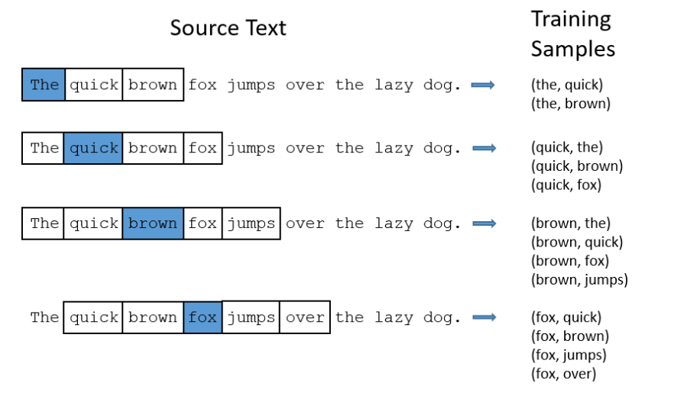
word2vec Recap
http://mccormickml.com/2016/04/19/word2vec-tutorial-the-skip-gram-model/

Slide 52
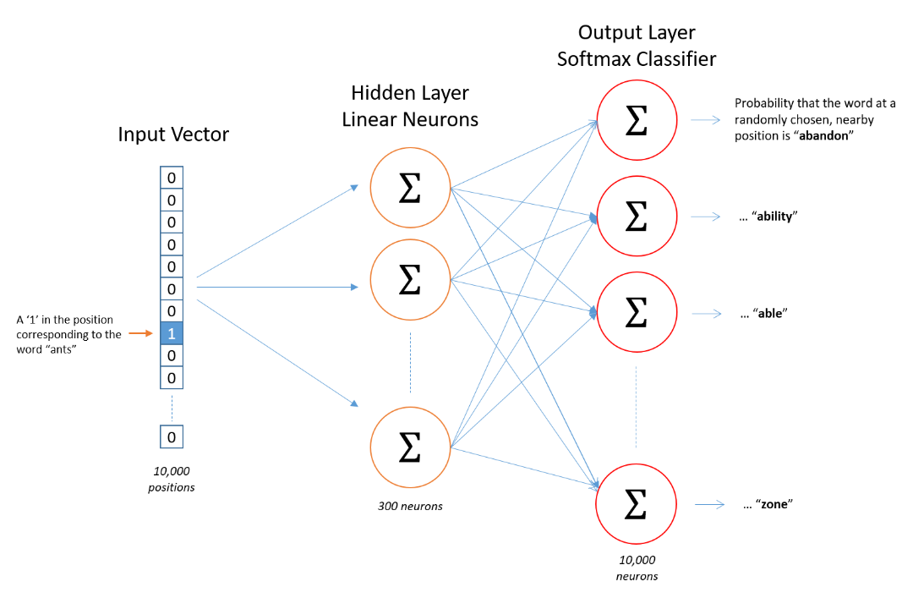
10k X 300
300 X 10k
http://mccormickml.com/2016/04/19/word2vec-tutorial-the-skip-gram-model/

Slide 53
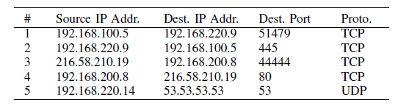
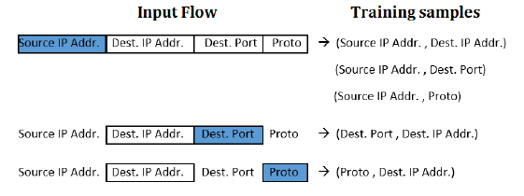
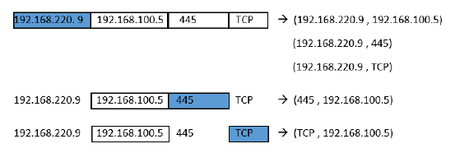
[Ring et al 2017]

Slide 54
IP2Vec
Differences from work2vec
Only a subset of inputs are used
And on a subset of features are used as context
Non-stationarity
[Ring et al 2017]

Slide 55
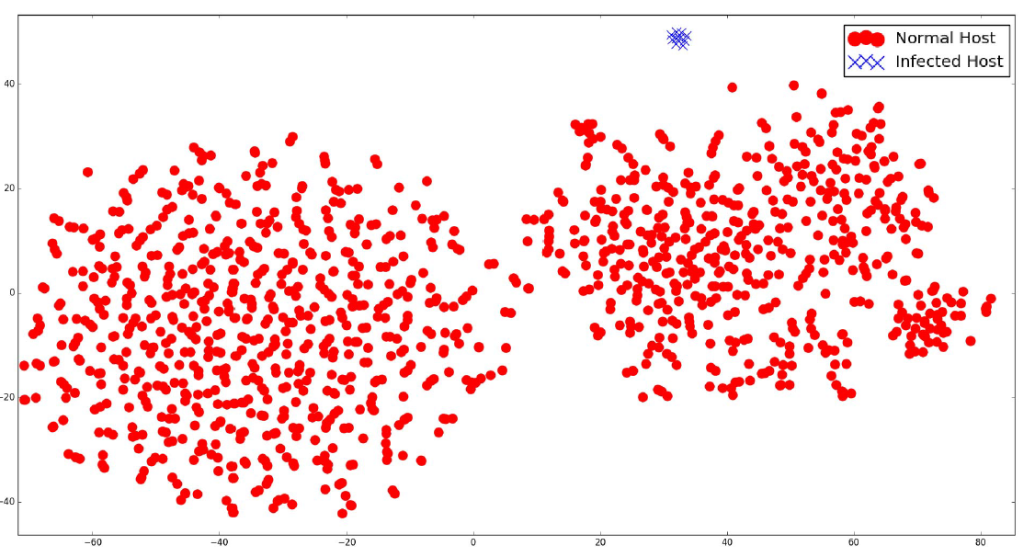
t-sne of embedding of IP addresses on CTU-13 data set
[Ring et al 2017]

Slide 56
Packet-based traffic data
Direct application of word2vec to payload data [packet2vec, Goodman et al. 2020]
TLS2vec [Ferriyan, 2022]

Slide 57
Traffic as an Image

Slide 58
Traffic as an image
Several researchers have proposed converting network traffic to images
Uses raw packet or flow data or extracted features
Mostly supervised, assuming availability of labeled data
CNN-based architectures are used
Temporal dependency is typically ignored

Slide 59
Malware Traffic Classification Using CNN for Representation Learning [Wang et al. 2017]
Detect known malware from network packet data
Created labeled data set with 10 types of malware traffic and 10 types of normal traffic
Notes:
Step 1: extract unidirectional or bidirectional flows
Step 2: anonymize IP addresses (if needed)
remove empty files – L7 data
Step 3: truncate (or pad) beyond some number of bytes (784, 28x28)
generate image: each byte is a gray-scale pixel (0 -> black, 256 -> white)
Step 4: save image a file

Slide 60
Wang et al. 2017
Notes:
Left image: randomly selected image from the 20 classes
Right image: 9 randomly selected images from 4 randomly selected classes
The authors concluded from visual inspection that there was sufficient consistently within classes
And sufficient discriminability between classes to try to train models.

Slide 61
Wang et al. 2017
Notes:
Two designs.
Both work well. All the three classifiers have very high precision / recall

Slide 62
CNN-based network intrusion detection against denial-of-service attacks [Kim et al. 2020]

Slide 63
Traffic as a Sequence

Slide 64
Traffic as a sequence
Flow data can be considered as a multivariate, temporal sequence
Several researchers have used LSTM / Transformer based architectures
Unsupervised / self-supervised anomaly detection

Slide 65
Attention-based self-supervised feature learning for security data [Lee et al. 2020]
Flows are extracted for users (IP’s) over time windows and clustered
Sequence to sequence encoder-decoder with attention

Slide 66
Epoch: 1
Epoch: 15
Epoch: 24
[Lee et al. 2020]

Slide 67
Traffic as a Graph

Slide 68
Traffic as a graph
Network traffic data intrinsically exhibits a graph structure
With machines/users as nodes and traffic between them as edges
Lot of work on extracting graph-based features from network traffic data (e.g., graph-based anomaly detection)
Can we learn graph-based features instead?

Slide 69
GNN
Learn embeddings for nodes

Slide 70
References
[Davis et al, 2011] Davis, Jonathan J., and Andrew J. Clark. "Data preprocessing for anomaly based network intrusion detection: A review." computers & security 30.6-7 (2011): 353-375.
Ring, Markus, et al. "Ip2vec: Learning similarities between ip addresses." 2017 IEEE International Conference on Data Mining Workshops (ICDMW). IEEE, 2017.
Francesco Bronzino, Paul Schmitt, Sara Ayoubi, Hyojoon Kim, Renata Teixeira, Nick Feamster (2022). Traffic Refinery: Cost-Aware Data Representation for Machine Learning on Network Traffic. In ACM SIGMETRICS, pp. 1–12, Mumbai, India.
Jordan Holland, Paul Schmitt, Nick Feamster, Prateek Mittal (2021). New Directions in Automated Traffic Analysis. In ACM Conference on Computer and Communications Security (CCS), pp. 1–14, Seoul, Korea
Wu, Kehe, Zuge Chen, and Wei Li. "A novel intrusion detection model for a massive network using convolutional neural networks." Ieee Access 6 (2018): 50850-50859.
Kim, Jiyeon, et al. "CNN-based network intrusion detection against denial-of-service attacks." Electronics 9.6 (2020): 916

Slide 71
Part 3: Synthetic Network Traffic Generation
Manish Marwah, Martin Arlitt

Slide 72

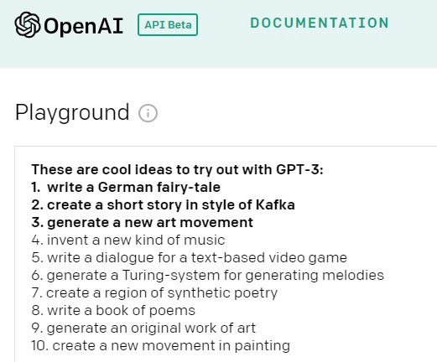
Generative Models
https://towardsdatascience.com/20-creative-things-to-try-out-with-gpt-3-2aacee3e2abf
https://thispersondoesnotexist.com/image
Notes:
Generative models are quite old but recently they have become really good
Most of the good results are for images and language
The most important challenge for building models with network traffic data is availability of data and the related privacy concerns.
One approach to addressing this problem is synthetically generated data

Slide 73
Generative methods
Learn P(x, y) instead of just P(x | y)
Kernel density estimation
Probabilistic Graphical models
Bayesian networks
…
Generative adversarial network (GAN)
Autoregressive neural model
Variational autoencoder
…

Slide 74
Evaluation
Once you generate synthetic data, how can it be validated?
Compare with real data:
Marginal distributions
Conditional distributions
Pairwise correlations
Mutual information
Use it for tasks that real data is used
Train ML models
Compare performance on real data

Slide 75
How do you learn to generate, say, netflow data?
Notes:
It is tabular data but more complex due to temporal dependence

Slide 76
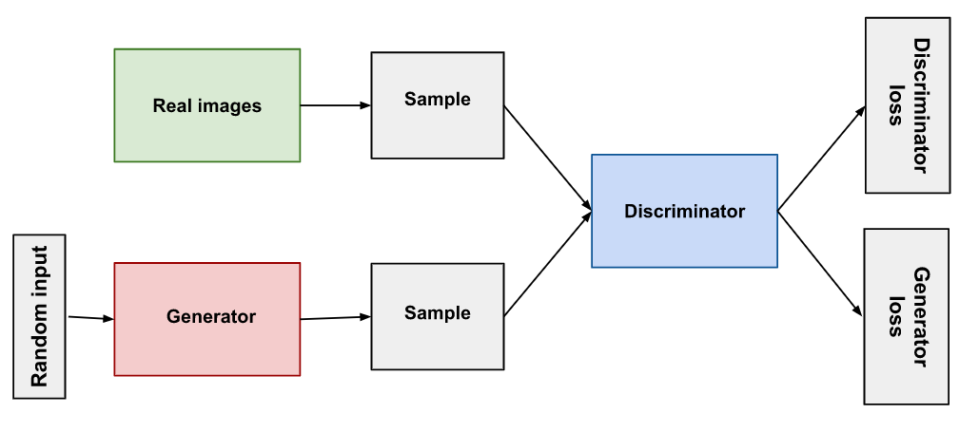
Generative Adversarial Network (GAN)
https://developers.google.com/machine-learning/gan/gan_structure
Notes:
Most of the work on traffic data generation uses GANs
So a quick recap of GANs

Slide 77
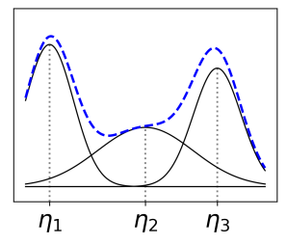
Modeling Tabular Data using Conditional GAN [Xu et al. 2019]
Tabular data is difficult to model using regular GANs
Mixed data types – continuous and discrete
Non-Gaussian, multimodal continuous distributions
Imbalanced categorical columns – can cause mode collapse
CTGAN addresses these issues
Mode-specific normalization for multimodal distributions
The generator is made conditional to solve the imbalance problem
Does not capture temporal dependence

Slide 78
Flow-based Network Traffic Generation using Generative Adversarial Networks [Ring et al. 2019]
Synthesize netflow data
Use Wasserstein GAN
Derive embeddings for netflow fields
Evaluation
Distributions
Domain tests

Slide 79
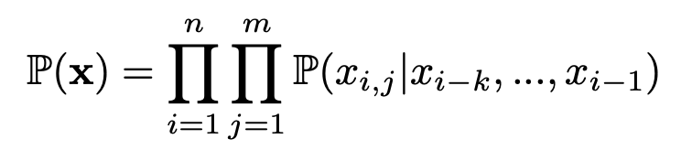
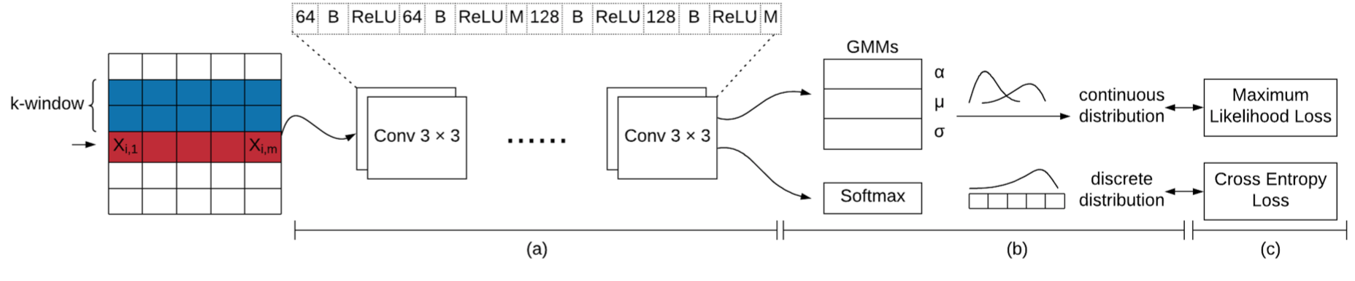
STAN: Synthetic Network Traffic Generation with Generative Neural Models [Xu et al. 2021]
Uses neural autoregressive model, similar to pixelCNN
CNN-based architecture to estimate conditional probability density
Captures temporal dependence as well

Slide 80
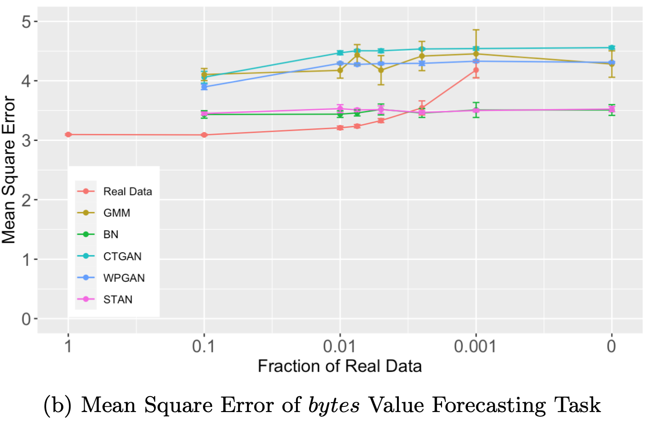
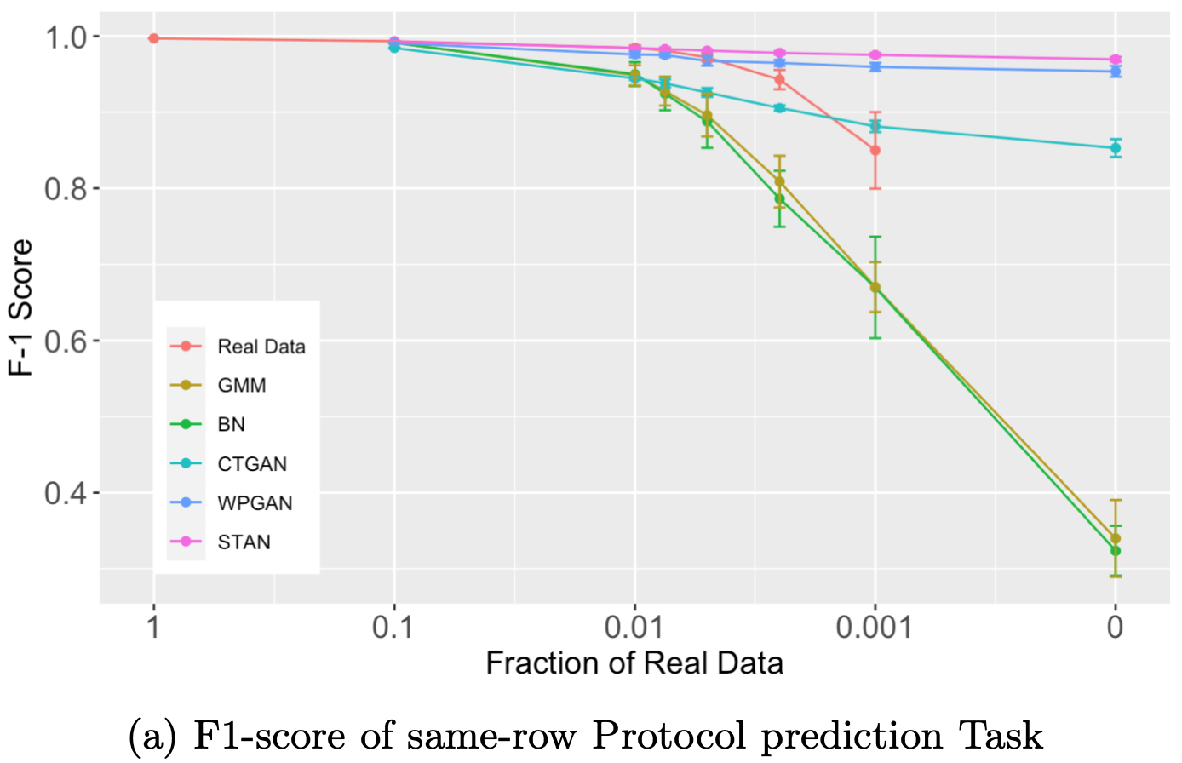
STAN: performance on ML tasks
[Xu et al. 2021]

Slide 81
Summary
Feature Learning
Synthetic data Generation

Slide 82
Research Challenges
Representative data sets
No true benchmarks
Privacy
Moving target – adverseries, non-stationary
Migation from on-prem to cloud

